Slide 1
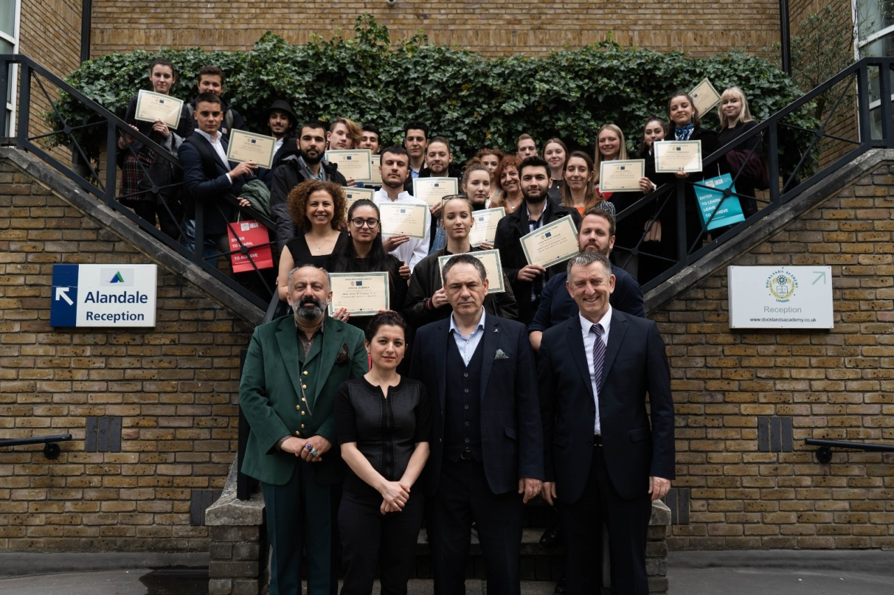
AEHT YOUTH PARLIAMENT (LONDON, 30.4 – 4.5.)
Made and presented by: Mirta Čenić, president of the AEHT Youth Parliament
Manifesto written by: members of AEHT YP
With the help of: Mr. Murray Cooper, prof.

Slide 2
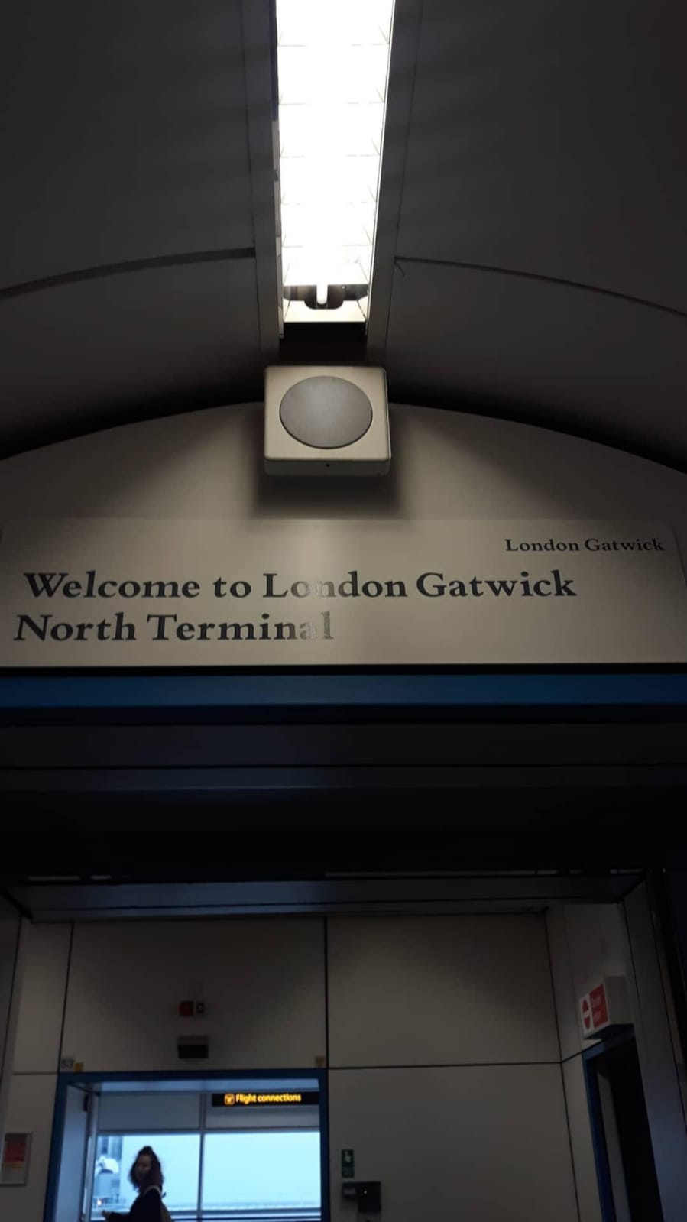

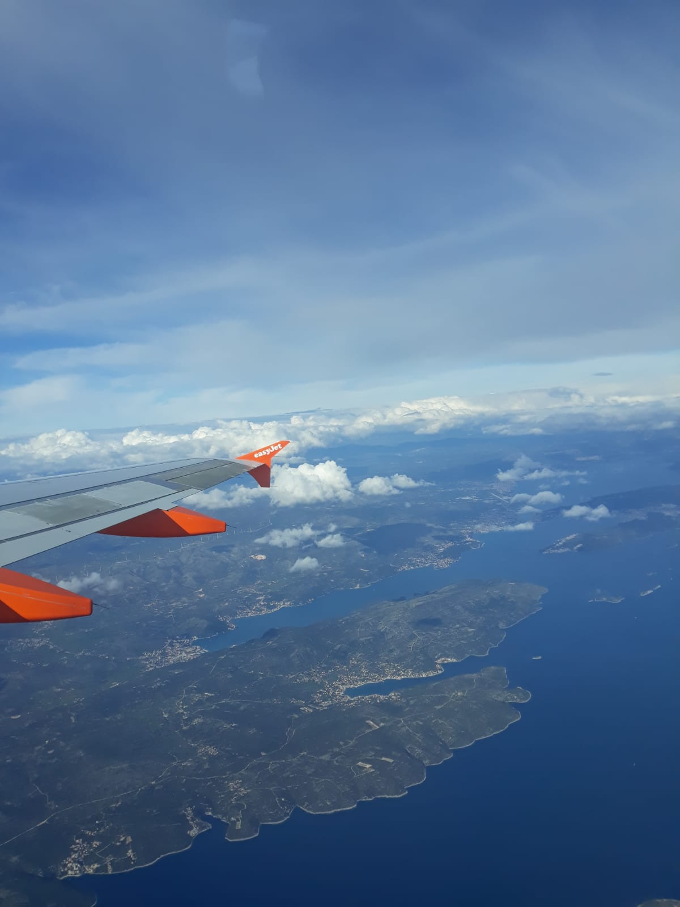
OUR TRIP TO LONDON

Slide 3
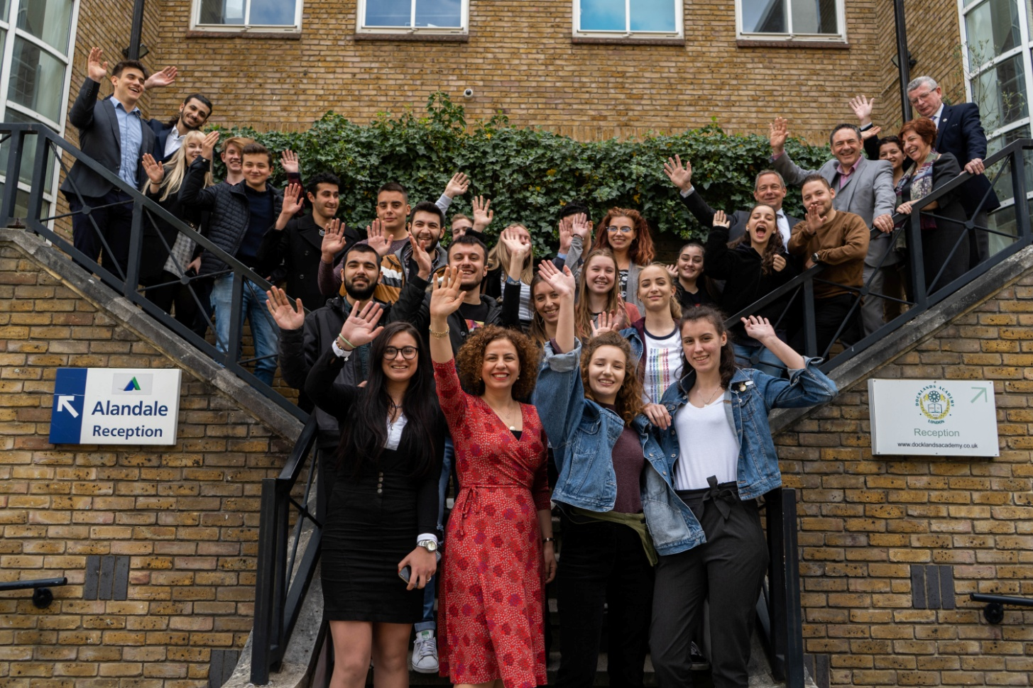
YOUTH PARLIAMENT
Docklands Academy in London
From April 30th to May 5th

Slide 4
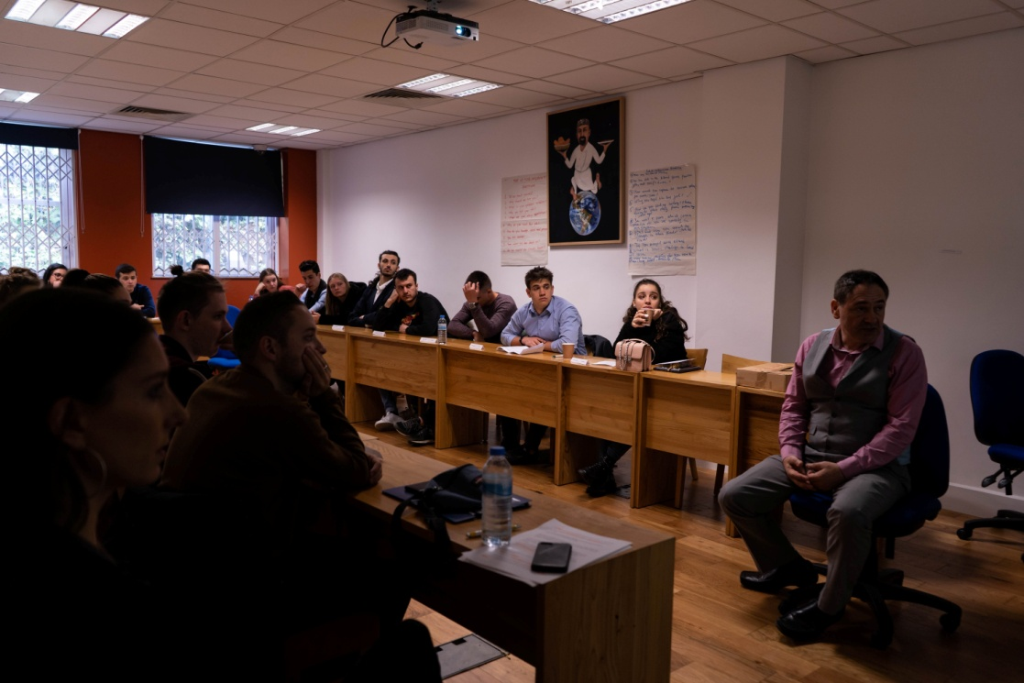
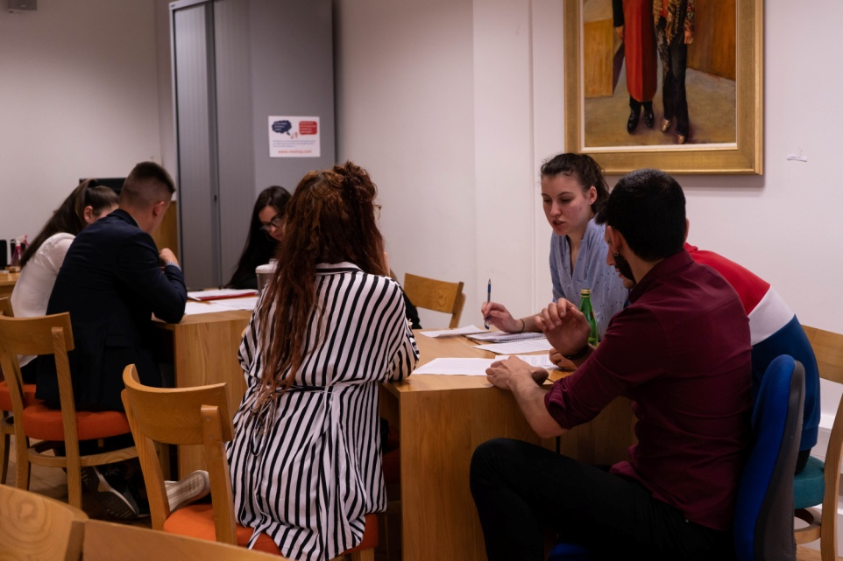
ACTIVITIES
Debates, presentations, writing The Manifesto
The topic was “Climate change and the Hospitality, Travel and Tourism industries”

Slide 5
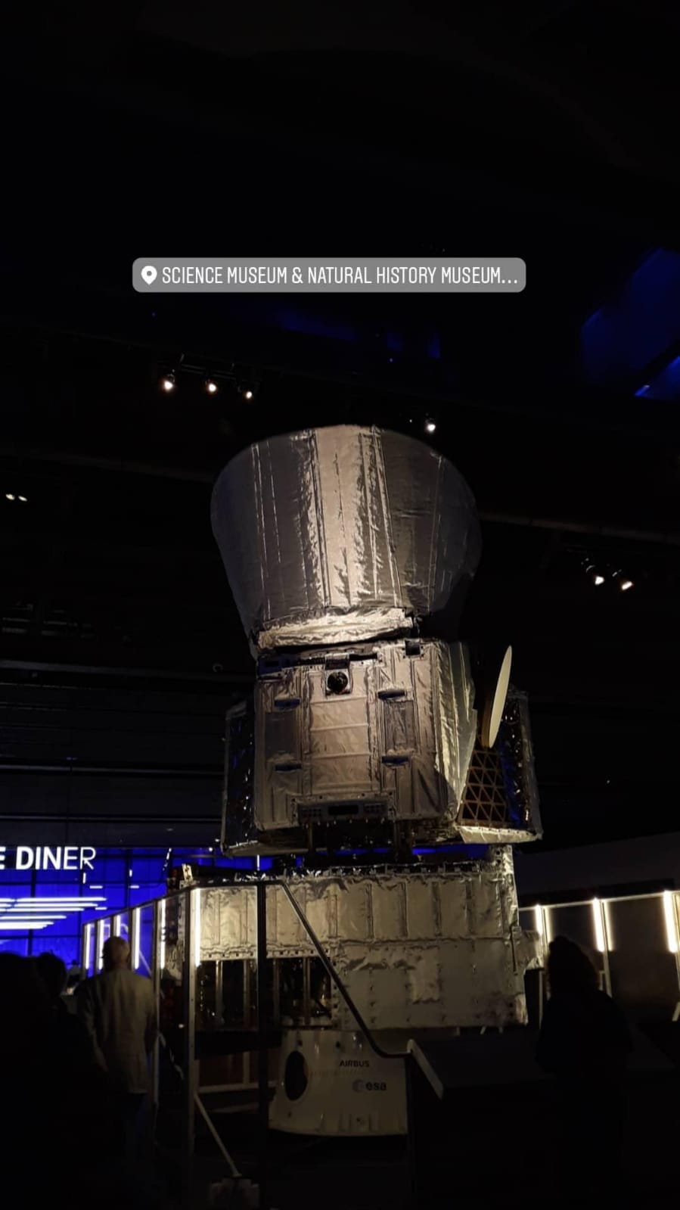
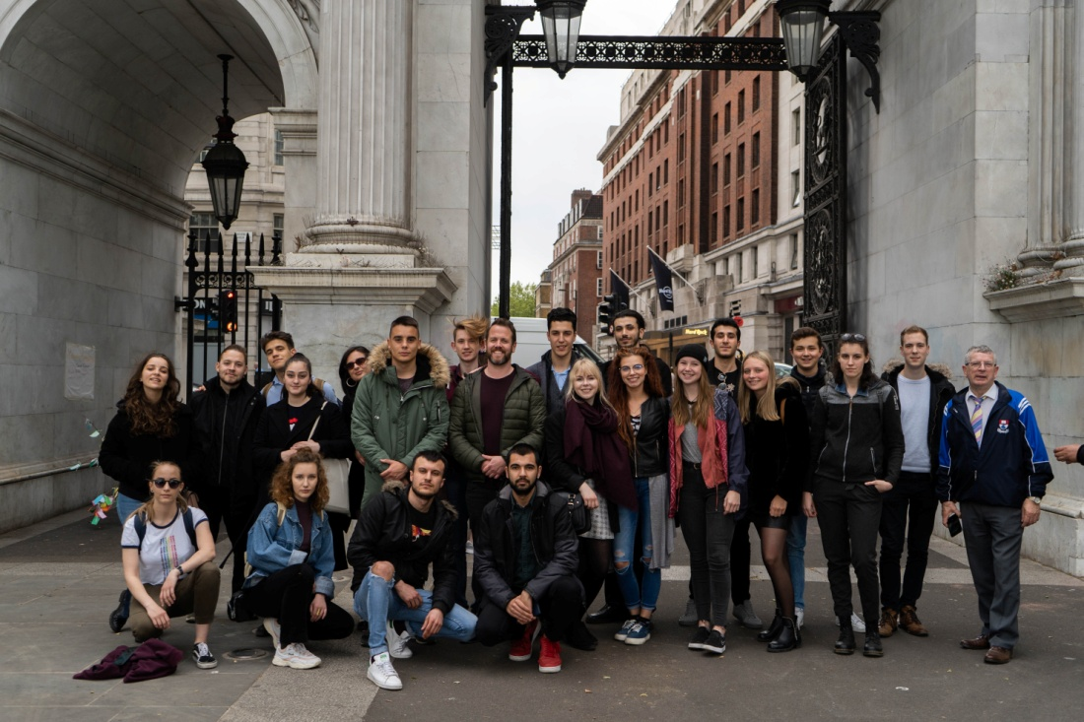
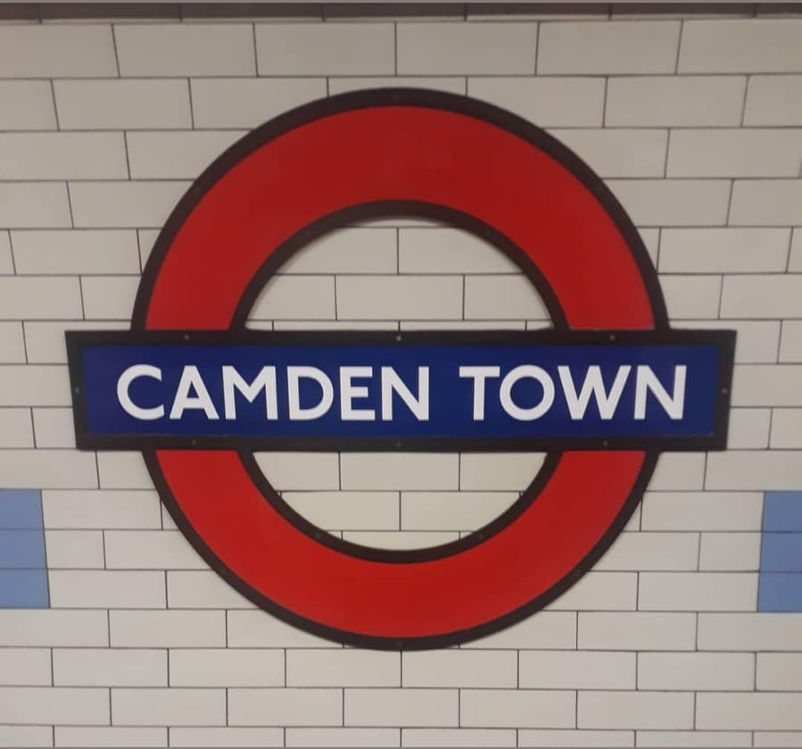
ACTIVITIES
Our stay was filled with leisure activities
We visited National History Museum, Princess Diana Memorial, London Bridge, Saatchi Gallery...

Slide 6
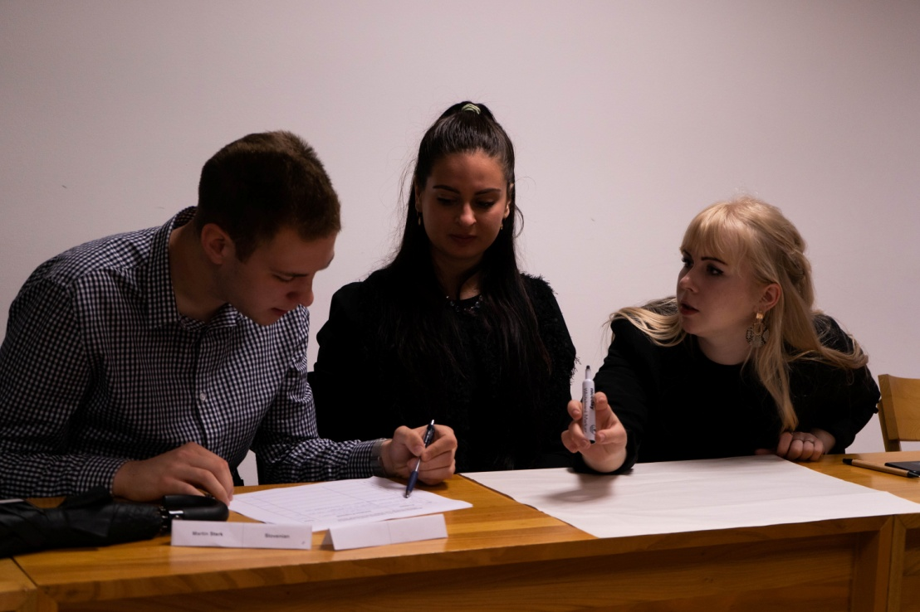
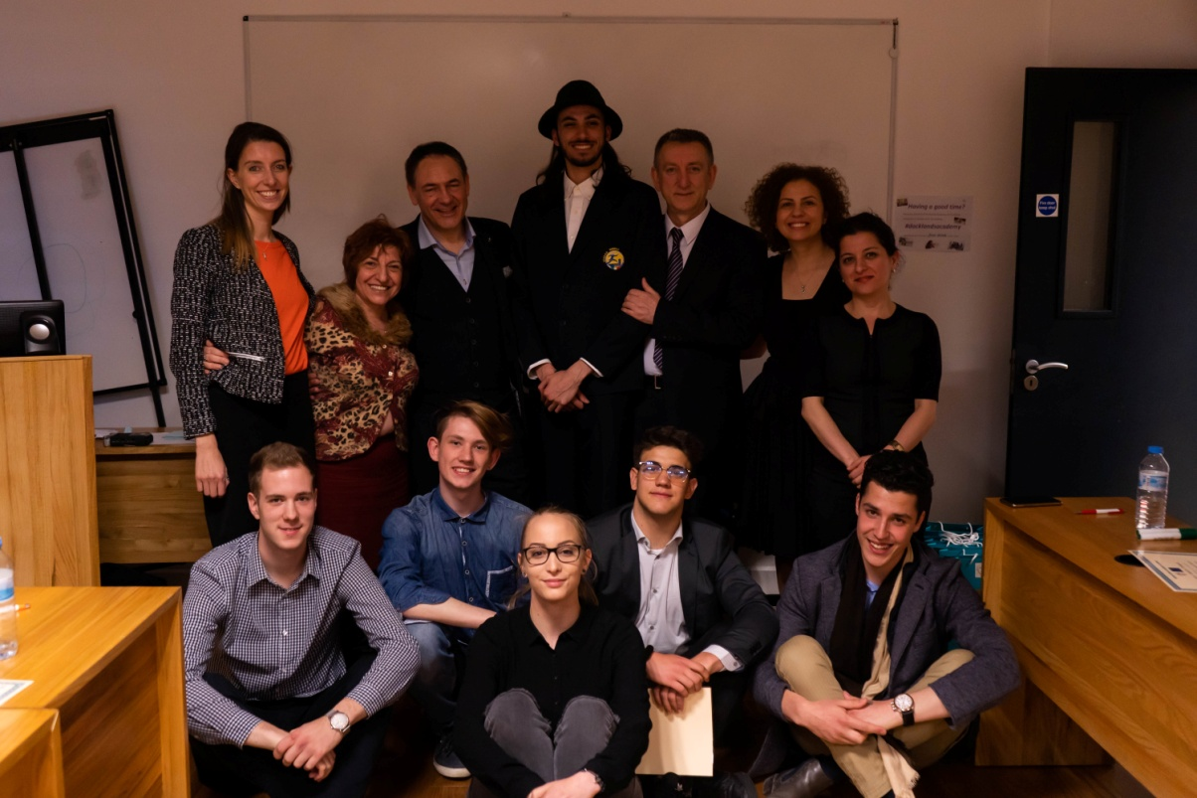
ELECTION OF THE PRESIDENT
We were separated in groups
Every nominee had his/her group and together had to write The Manifesto and present it

Slide 7
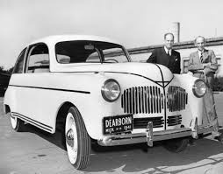
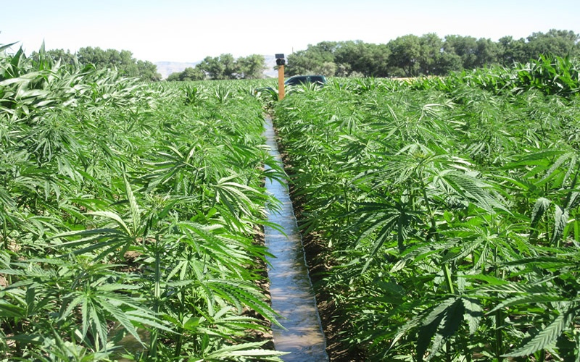
THE MANIFESTO
Lowering the price of industrial hemp
Wholly replacing plastic
Lower prices of hemp would encourage tourism entrepreneurs to use more hemp and less plastic

Slide 8


THE MANIFESTO
Educating about the importance of the ecology
offering distinct educational programmes on ecology and climate change, which are tailored to appeal to different social groups

Slide 9



THE MANIFESTO
Buying organic food and supporting small local farms and factories
Reduces gas emissions caused by transportation
Helps the community to develop

Slide 10

THE MANIFESTO
Green taxes
Green taxes can discourage behaviour that is damaging for the environment and people
Higher taxes on plastic bottles and plastic bags

Slide 11
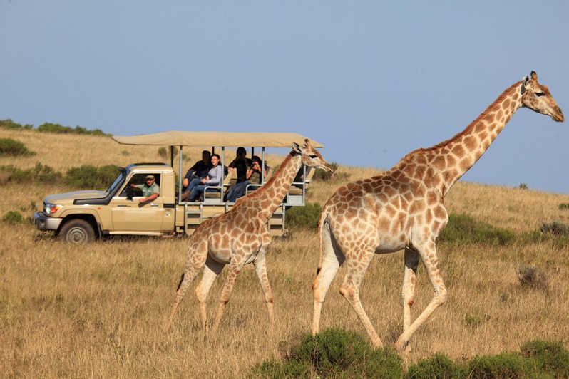
THE MANIFESTO
Stricter laws regarding zoos
Zoos sometimes help endangered species but in many zoos, animals are kept in cages and receive poor care
Expensive tickets = more money for good care of animals

Slide 12


THE MANIFESTO
Monitoring waste from hotels and other establishments
a law where a business would have to pay if it creates more pollution than the government allows
replacing plastic cups, straws and plates with glass or other reusable materials

Slide 13
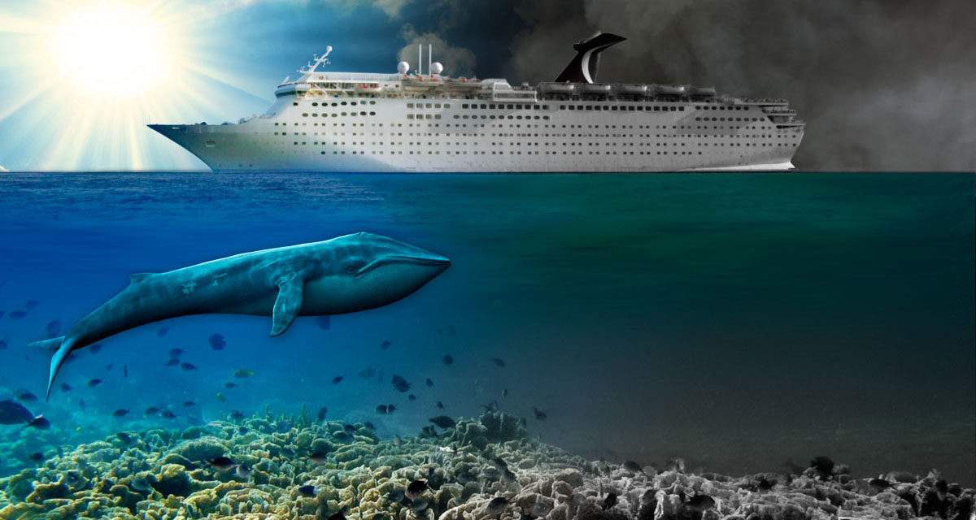
THE MANIFESTO
Cruise ships
imposing higher taxes on cruise holidays
creating special harbors for cruise ships to visit
restrictions on where cruise ships could travel

Slide 14

THE MANIFESTO
Serving as an example
the most important part
This industry has an enormous potential of serving as an example of behavior to people inside and outside of HTT

Slide 15
THANK YOU FOR ATTENTION!

