Slide 1
2019 AEHT WORKSHOP Enhancing training methodologies through THe use of Simulators and gamification
Porto, May (9th to 12th)

Slide 2
Organizers: Escolas do Turismo de Portugal
Target: Tourism & Hospitality Teachers (EQF5 and higher)
Goals:
Sharing good practices of the use of simulators in teaching and training Tourism & Hospitality
Benchmarking experiences and software solutions
Presentation of one Simulator (CESIM)
WORKSHOP IS HELD IN ENGLISH ONLY!
.If you want to share your experience, please send an abstract of your presentation in one (1) page A 4 (maximum 2.000 characters) themed "Enhancing training methodologies by the use of Simulators" to paulo.vaz@turismodeportugal.pt till the 25th April 2019.
2019 AEHT WORKSHOP Enhancing training methodologies through THe use of Simulators and gamification
Porto, May (9th to 12th)

Slide 3
Thursday (day 1): 09/05
Arrival to Porto
19:00 Casual Get Together @ Escola de Hotelaria e Turismo do Porto (EHTP)
Friday (day 2): 10/05
09.00 Welcome & Opening moment @ EHTP
09:45 Presentation “Portugal, the place to be!” (EHTP students)
10:30 Introduction of participants and Information on “Enhancing training methodologies by the use of Simulators“ (Paulo Morais Vaz & Rui Santos)
11:00 Presentation of CESIM Simulator & Case Study (Telmo Silva)
13.00-14.30 Lunch at EHTP
2019 AEHT WORKSHOP Enhancing training methodologies through THe use of Simulators and gamification
Porto, May (9th to 12th)

Slide 4
Friday (day 2): 10/05 (cont.)
14:30 Guided tour through EHTP (EHTP students)
15:00 Exchange of good practices / successful teaching strategies in tourism, hospitality and F&B management (all participants)
17:30 Coffee break
18.00 Closing the day! (Paulo Morais Vaz & Rui Santos)
18:30 Free Time
21:00 Dinning in Porto – discover Portuguese wines & gastronomy
2019 AEHT WORKSHOP Enhancing training methodologies through THe use of Simulators and gamification
Porto, May (9th to 12th)

Slide 5
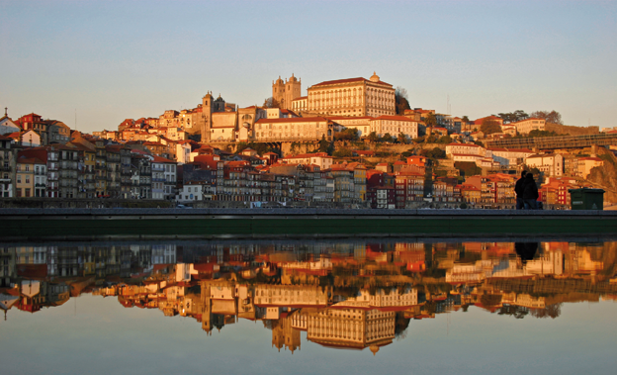
Saturday (day 3): 11.05
09.30 Exchange of good practices / successful teaching strategies in tourism, hospitality and F&B (cont.)
11:00 Coffeee break
11.30 Conclusions presentation & next meeting theme definition
13:00 Lunch time
15:00 Walking tour in Porto: City Hall, São Bento Railway station, Sé, Ribeira, Wine Cellars.
18:30 Return to the hotel & Free time
21:00 Dinner @ Surprise!!!!!
Sunday (day 4): 12.05
During all day: Departure ☹
2019 AEHT WORKSHOP Enhancing training methodologies through THe use of Simulators and gamification
Porto, May (9th to 12th)

Slide 6
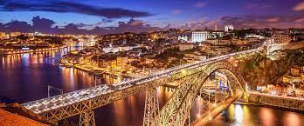
Terms & Conditions
.Price includes:
- 3 nights at hotel (single room BB basis @ StayInn Hotel or similar
- All meals (from Thursday dinner till Saturday dinner)
- Transfers from airport to hotel and vice-versa.
.Excluded: return flight to Porto, personal expenses and SHOPPING! ☺
.Price 395€ (EARLY BIRD RATES AVAILABLE UNTIL 24/03/2019)
After this date, admittance dependent on availability
Bank details (NB.: Bank transfer costs must be covered by the attendees):
IBAN: PT50 0035 0310 00037527330 28 // BIC SWIFT: CGDIPTPL
Together with your confirmation email, send a copy of the bank receipt to paulo.vaz@turismodeportugal.pt
Special price for those attending only the Workshop – 115€ !!!
Meals included
2019 AEHT WORKSHOP Enhancing training methodologies through THe use of Simulators and gamification
Porto, May (9th to 12th)

Slide 7
See you in Porto!
Welcome to Escolas do Turismo de Portugal @ http://escolas.turismodeportugal.pt/
2019 AEHT WORKSHOP Enhancing training methodologies through THe use of Simulators and gamification
Porto, May (9th to 12th)
Please note that there might be changes in the programme (timetables), and that the Seminar will only be held, if there are more than 12 participants!

