Slide 1
From a rookie to an expert – International paths for VET staff, REX VET
Mari Kontturi, Luovi Vocational College (FI)
Ave Paaskivi, Kuressaare Ametikool (EE)

Slide 2
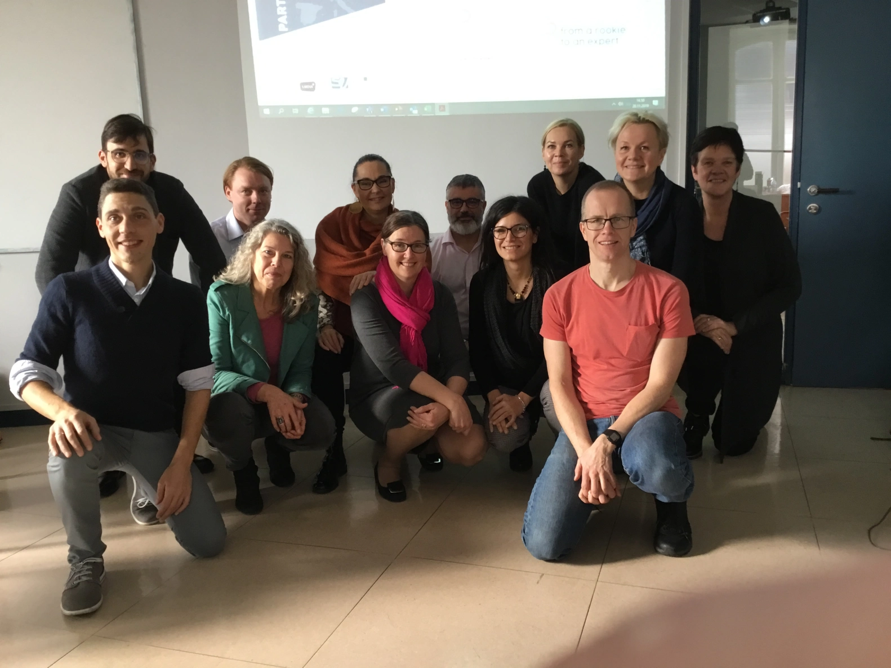
Team
Ammattiopisto Luovi, Finland
Live, Finland
Kuressaare Ametikool, Estonia
ENAC, Italy
Centro San Viator, Spain
Alfa-college, the Netherlands

Slide 3
Understanding the Core Skills of VET staff
Many ways to participate in international activities, different types of tasks e.g. coordinating outgoing mobilities, coordinating incoming mobilities, writing applications, organising events, internationalisation strategies, infos, practical arrangements, virtual collaboration, networking and partnerships, internationalisation in teaching and learning
Different skills needed
Carrying out a small survey in your organisation
Existing experience, skills and competences
Objectives
Training needs
Erasmus+ offers many possibilities to support staff development

Slide 4
What do we do in REX VET?
From a rookie to an expert
Existing skill and competences
Survey
What skills and competences are needed? Focus group discussions
Internationalisation path
How to support development
Training package
How to demonstrate your skills and competences
Open Learning Badges

Slide 5
Objectives
to increase the ownership of internationalisation activities within the organization and engage more teachers and staff members in such activities.
Engaging more teachers in international activities is crucial in order to increase the attention to the European context, develop new curriculum planning process and new curriculum models and help to widen cultural understanding among students.
to develop and recognize the skills and competences that are needed in the global world and internationalisation of education from “a rookie to an expert”.

Slide 6
Objectives
to promote staff development in terms of internationalisation skills such as more knowledge about the EU, better understanding of other VET systems, language and managerial skills and updating the skills needed to work in a multi-cultural environment.
to promote the link between international activities and the strategy and development of the organisation and staff professional development.

Slide 7

Products
Mapping the international skills of the staff in partners organizations
Personal development path model in international skills for staff in VET
Training package to support the skills development
Digital learning badges to document and recognize the learning and skills gained in internationalization

Slide 8
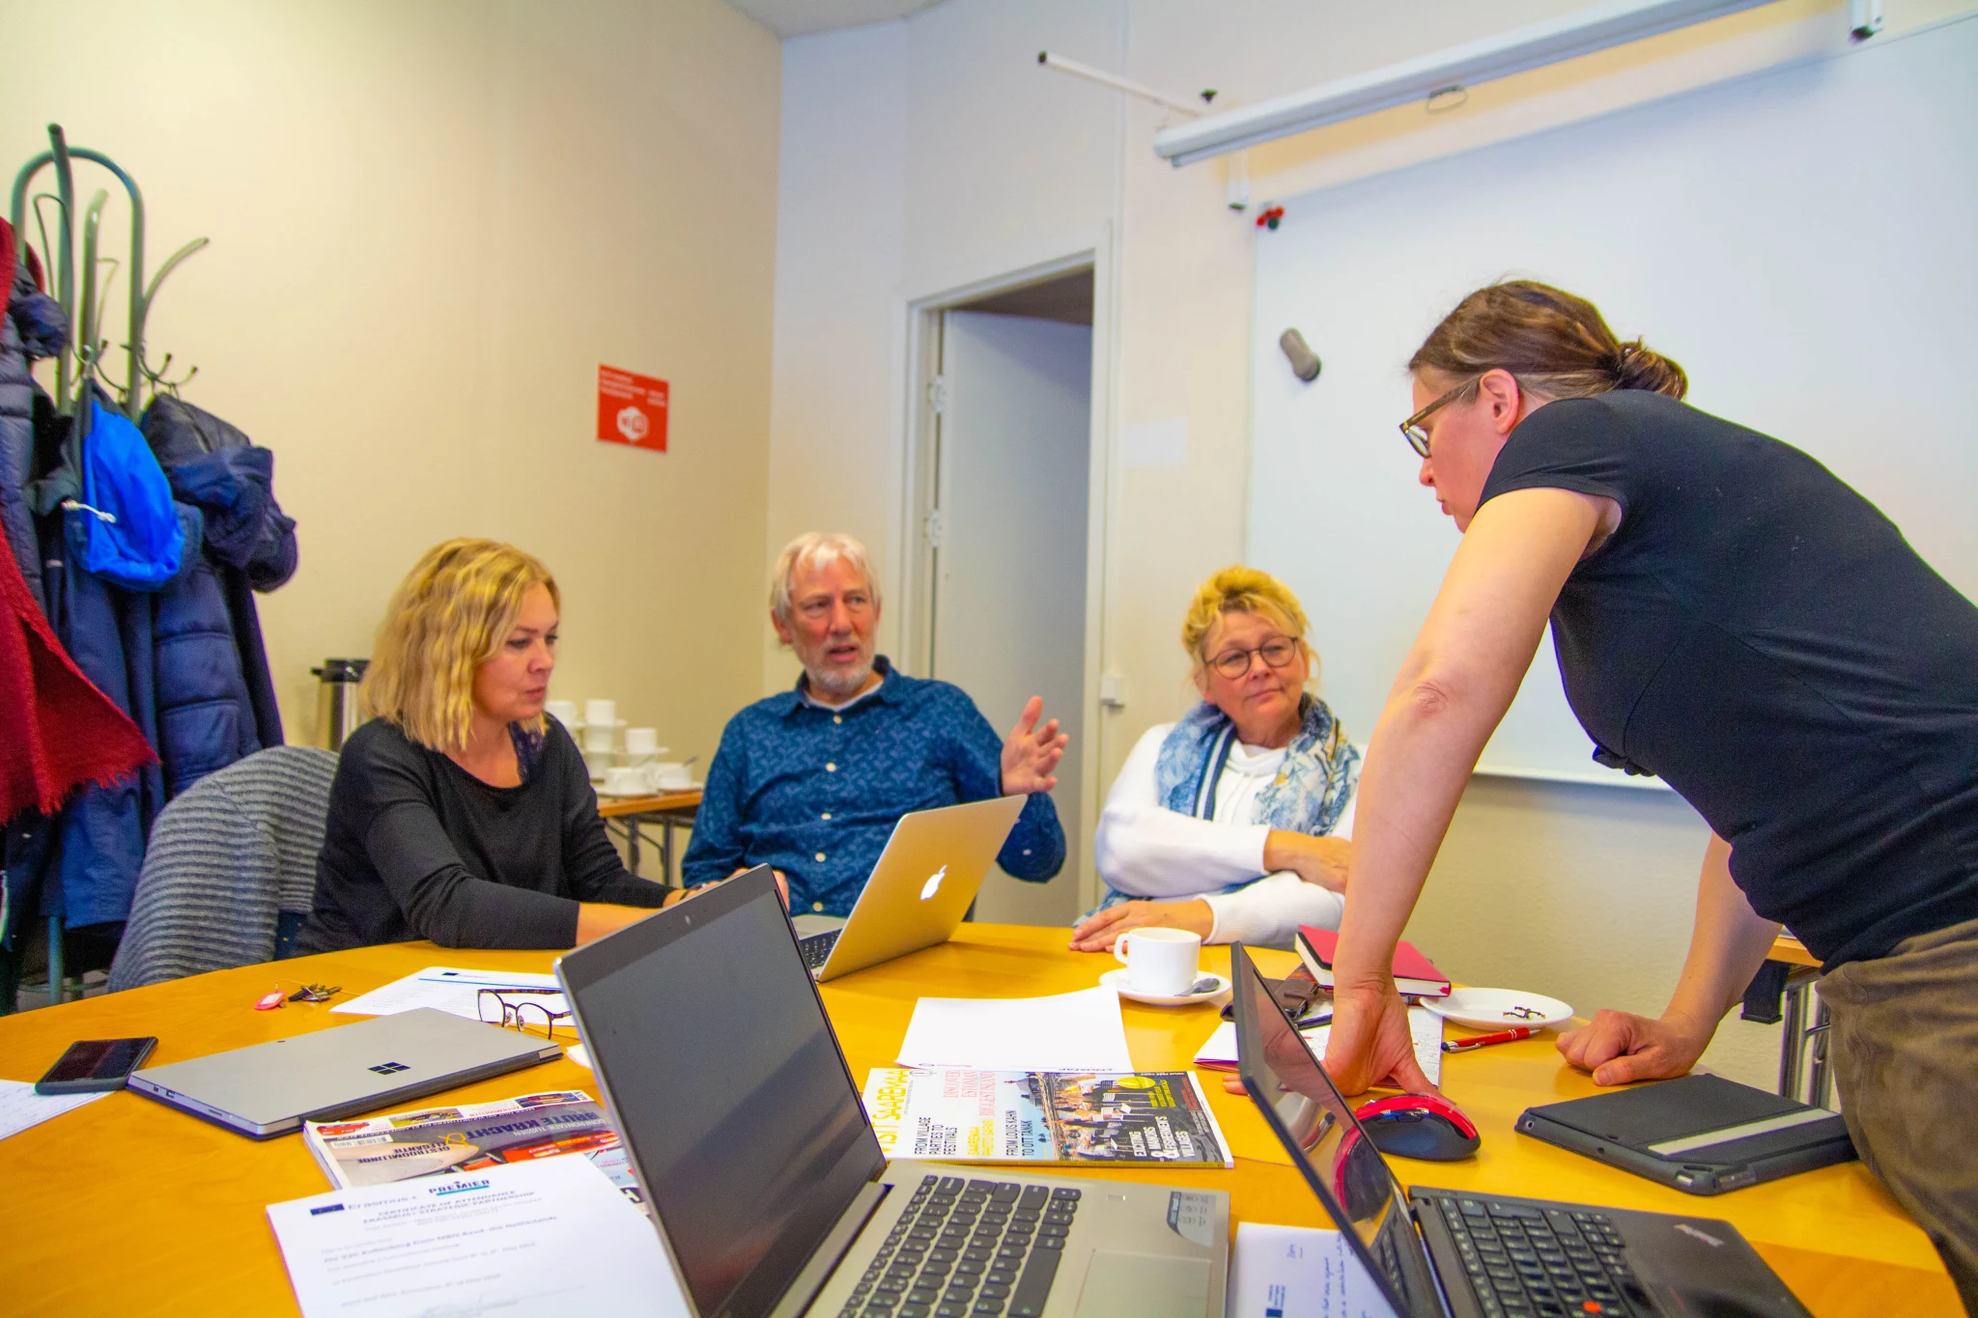
Benefits of internationalisation
taking part in projects gives you positive emotions and new friends.
You become a better teacher and it widens your perspective.
It helps you to nurture student’s motivation and perspective for their speciality.
You familiarize yourself to new teaching methods.
It helps you understand what’s important and sometimes how well you’re doing.
In addition to that drinking wine was mentioned

Slide 9
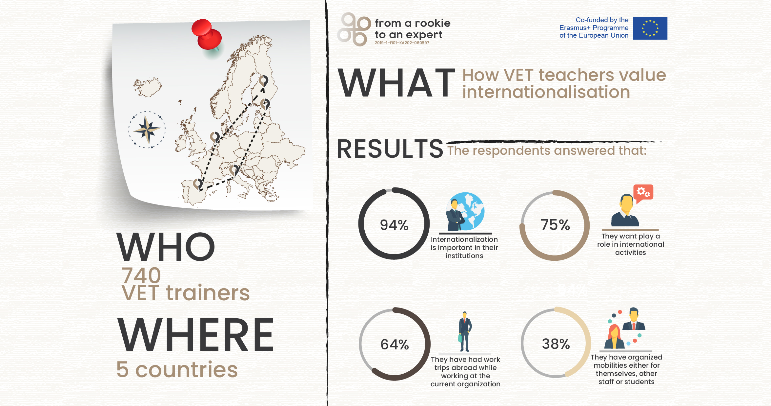

Slide 10
VET staff international career model
It has been a journey and the process still goes on defining the steps in internationalisation path

Slide 11
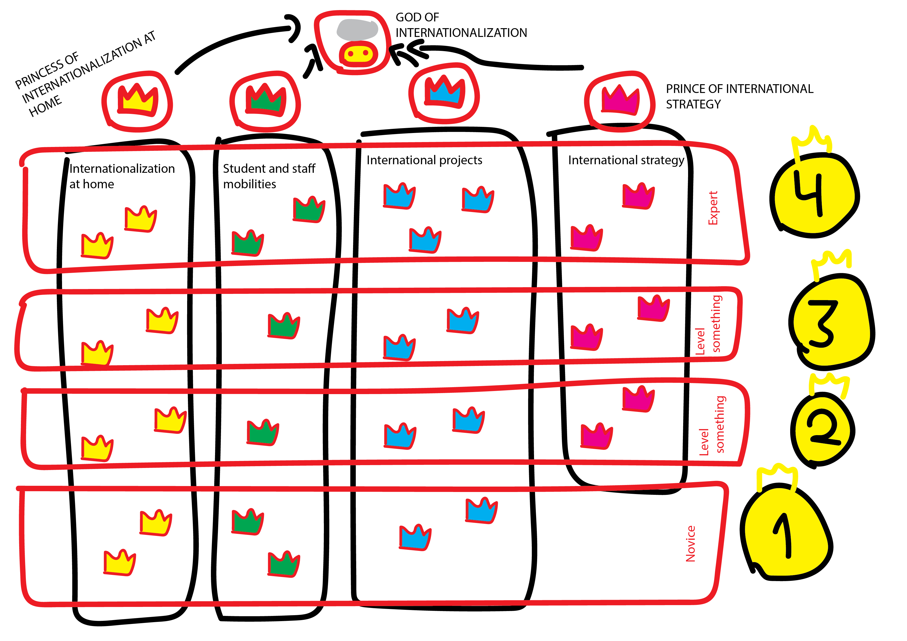

Slide 12
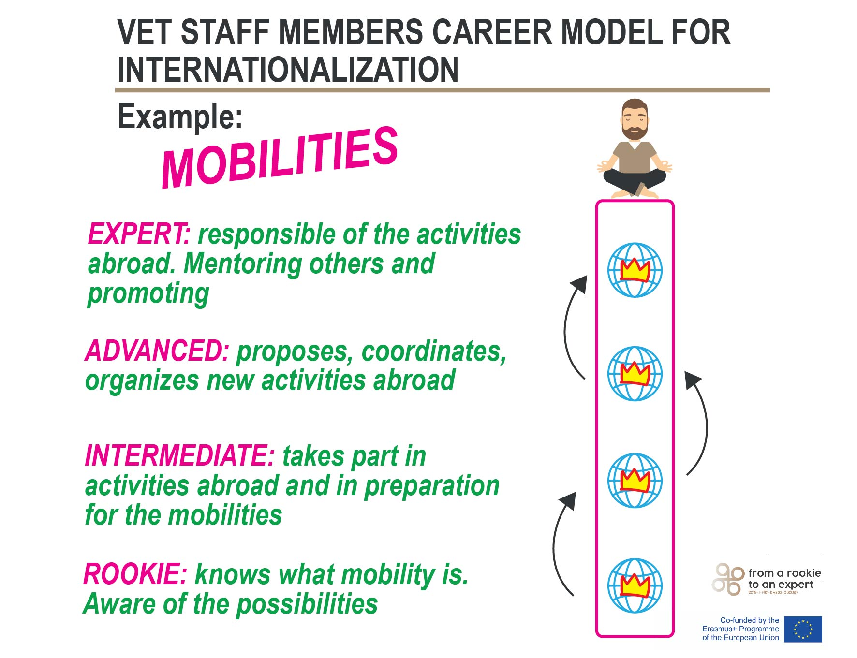

Slide 13
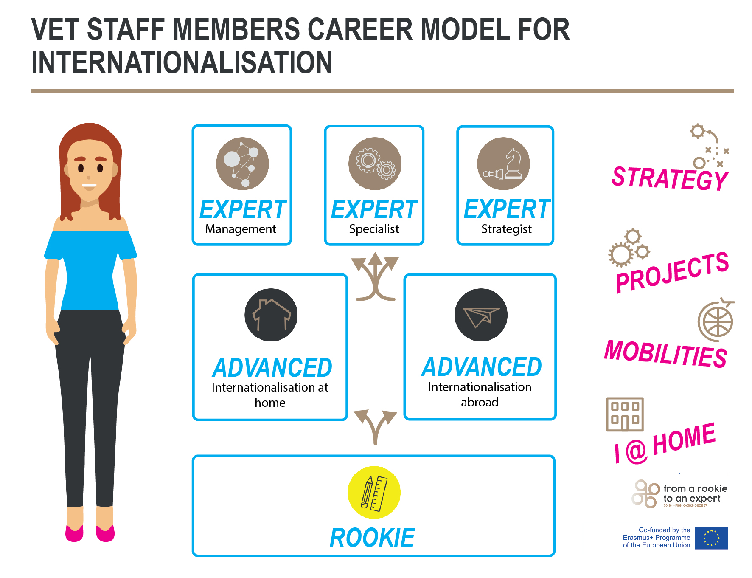

Slide 14
Training Material
6 training modules:
Rookie – basic knowledge about internationalisation
Internationalisation at home – activities to carry out/promote at H
Internationalisation abroad – activities to carry out/promote A
Management – how to apply and manage projects
Specialist – activities abroad in expert level
Strategist – development and strategy work

Slide 15
https://luovi.fi/en/rex-vet-from-rookie-to-an-expert-landing-page/

Slide 16
Open Learning badges
Training materials to support growing from a rookie to an expert
Linking with the HR and the staff development processes in the organisations
Demonstrating your skills and competences with Open Learning Badges
Making skills visible
Making learning more attractive

Slide 17

model
REX VET Blog – From a rookie to an expert – International paths for VET staff (wordpress.com)

Slide 18
Thank you, aitäh
Contact information:
Ave Paaskivi
Mari Kontturi
https://luovi.fi/luovi/projektit/from-a-rookie-to-an-expert-international-paths-for-vetstaff/

